Slide 1

How to Optimize Telehealth
in a Post-COVID 19 World
OCBH and Genoa Telepsychiatry

Slide 2






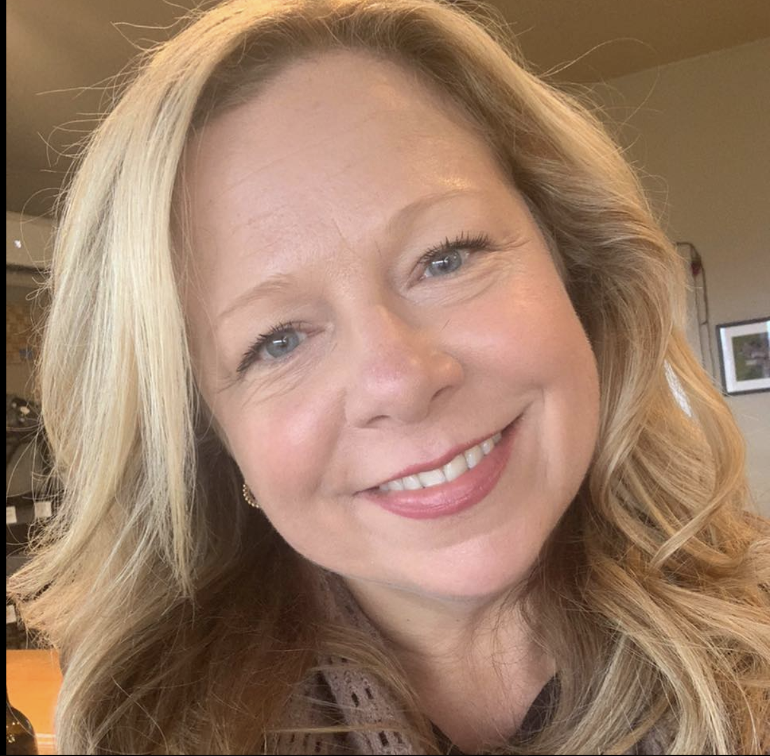
Speakers
David
Theobald
LeeOr
Klein
Heather
Jefferis
Jackie
Fabrick
Amy
Converse
Kristin
Garcia
Senior Telepsychiatry Partnerships Manager
Genoa Telepsychiatry
Policy
Strategy
Lead
Genoa Telepsychiatry
Executive Director
Oregon Council for Behavioral Health
BH Medicaid, Policy and Analytics Manager
Oregon Health Authority
Director of Organizational Excellence
Lutheran Community Services Northwest
Director for Medical and Integrated Behavioral Health Services
Lifeworks Northwest
Kelly
Mack
Pacific Northwest Clinic Partnerships Associate
Genoa Telepsychiatry
Notes:
For patients, as we talked about earlier, follow-up care is vital for long-term positive outcomes.
We measure the success of telepsychiatry programs mainly by: % of follow-up visits and average # of visits throughout treatment to show continuity of care.
As you can see, Genoa Healthcare’s telepsychiatry programs on average render 85% follow-up visits and 5 visits during a patient’s treatment.

Slide 3
Agenda
The Shift to Telehealth
National Regulatory Changes
State Regulatory Changes
Case Study: Lutheran Community Services Northwest
Case Study: Lifeworks Northwest
Q&A
Notes:
The Shift to Telehealth
National Regulatory Changes
State Regulatory Changes
Case Study #1: Lutheran Community Services Northwest
Case Study #2: Lifeways Northwest
Questions

Slide 4
Heather Jefferis, Executive Director of the OCBH
Heather Jefferis as the Executive Director of the Oregon Council for Behavioral Health participates in a wide variety of forums to ensure our members voice is present and actionable.
Over the last 23 years of working in Behavioral Health both Substance Use Disorder and Mental Health, I have been privileged to sit in a variety of seats. I have provided direct services as a master’s level clinician, served as a program director, an Executive and Board Chair. I have developed, implemented and operated programing within government BH clinics, non-profit clinic settings and criminal justice programs. In each of these seats I have typically served individuals who are multisystem involved and frequently with co-occurring concerns. I intimately understand Oregon systems that support Oregonians on their path to whole person and family health. As the Executive Director of the Oregon Council for Behavioral Health, I have been charged by the OCBH Board to grow this local association representing the statewide integrated continuum of Behavioral Health Care in Oregon.
OCBH has over 40 members providing the full continuum of services from prevention
through residential services and detox.

Slide 5


Oregon Council for Behavioral Health
Oregon Council for Behavioral Health is a member driven association providing advocacy, lobbying, training, system level governmental partnership, information, networking and organizational support for its membership.
The association works on both the state and national level to assure BH services are equitably accessible and individually informed across our state.

Slide 6








OCBH Recent Success
Increases in SUD and MH rates
Telehealth access advocacy
Reductions of admin burden
Consumer protections from sub par-providers
COVID-19 relief funding access
Legislator BH awareness and attention
Member operations forums to support rapid innovation and internal practices
Increased number of preferred partner vendor rates and customer service delivery

Slide 7
The Shift to Telehealth

Slide 8
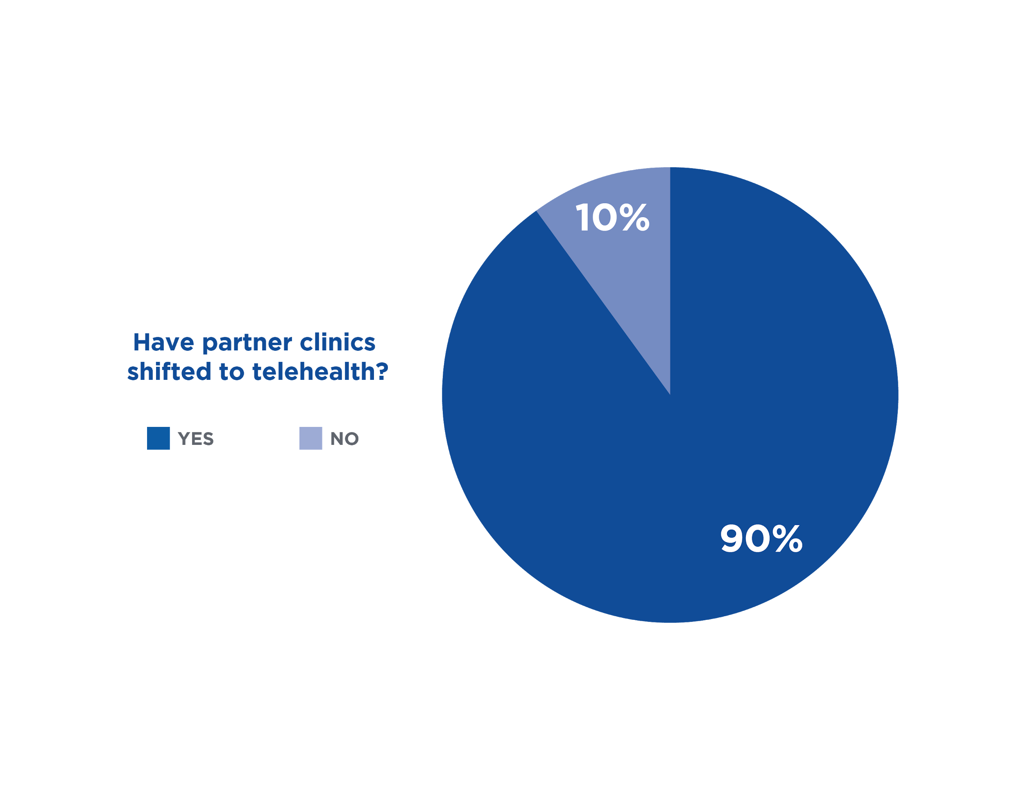
90% of Public Health Clinics Now Use Telehealth
*Optum Behavioral Health database, 2020
Notes:
For patients, as we talked about earlier, follow-up care is vital for long-term positive outcomes.
We measure the success of telepsychiatry programs mainly by: % of follow-up visits and average # of visits throughout treatment to show continuity of care.
As you can see, Genoa Healthcare’s telepsychiatry programs on average render 85% follow-up visits and 5 visits during a patient’s treatment.

Slide 9
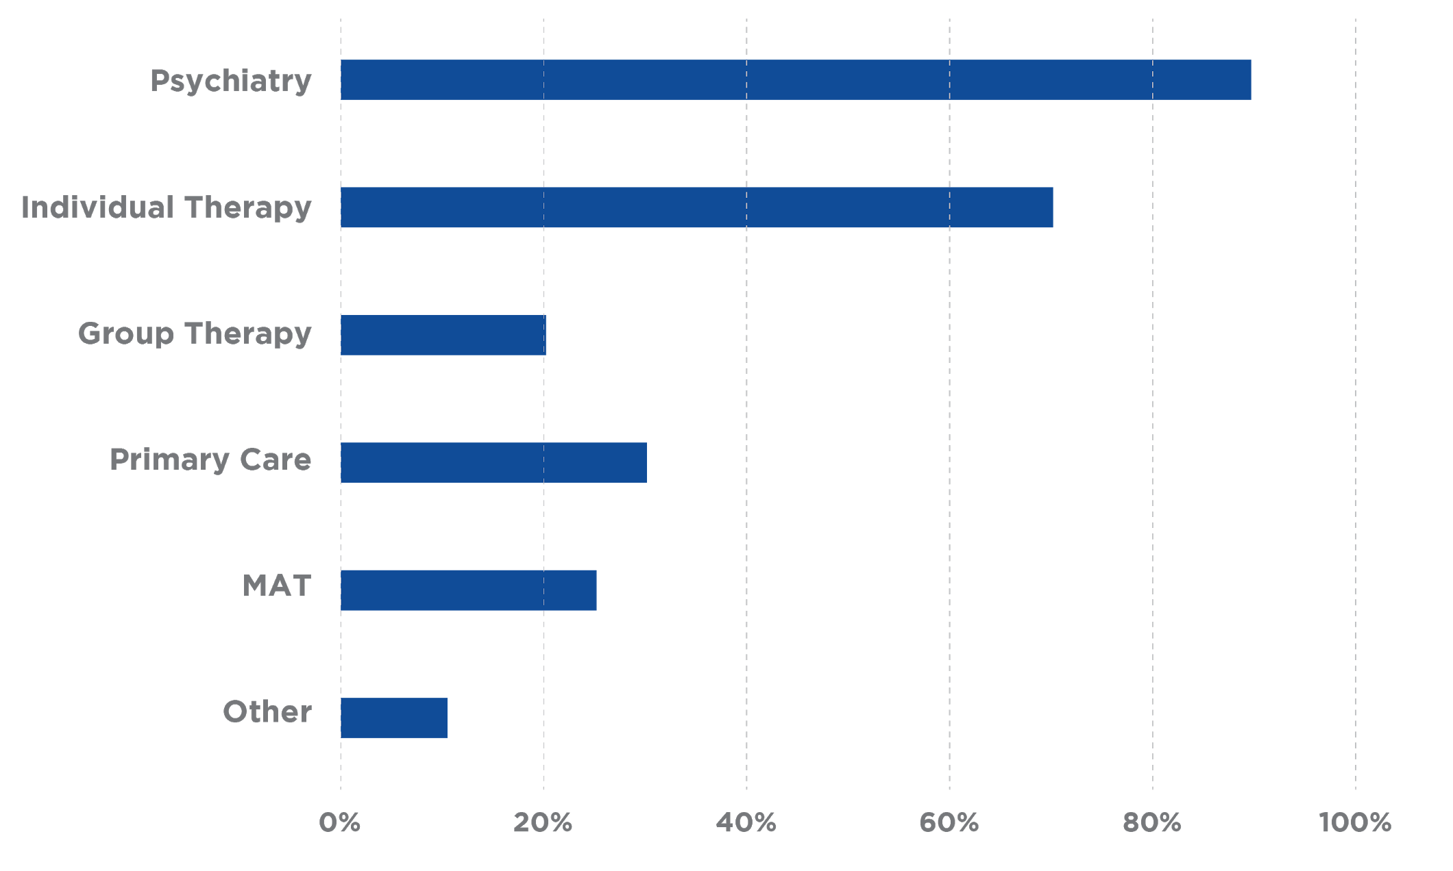
90% of Psychiatry Sessions and
70% of Therapy Sessions via Telehealth
*Optum Behavioral Health database, 2020
Notes:
For patients, as we talked about earlier, follow-up care is vital for long-term positive outcomes.
We measure the success of telepsychiatry programs mainly by: % of follow-up visits and average # of visits throughout treatment to show continuity of care.
As you can see, Genoa Healthcare’s telepsychiatry programs on average render 85% follow-up visits and 5 visits during a patient’s treatment.

Slide 10
Clinical Trends
CLIENT UTILIZATION
CLIENT BEHAVIOR
PROVIDER BEHAVIOR
Improved via telehealth with no show rate dropping to 5-10%
Most started just phone, most now also video, no material differences by age or acuity
Most comfortable treating clients at home assuming recent physical or clinic visits for vital checks and lab tests
* Genoa Telepsychiatry database, 2020
Notes:
For patients, as we talked about earlier, follow-up care is vital for long-term positive outcomes.
We measure the success of telepsychiatry programs mainly by: % of follow-up visits and average # of visits throughout treatment to show continuity of care.
As you can see, Genoa Healthcare’s telepsychiatry programs on average render 85% follow-up visits and 5 visits during a patient’s treatment.

Slide 11



Care Delivery Post-COVID 19
TELEHEALTH ADOPTION
VIDEO VS. VOICE
ON-SITE VISITS
CLEAR BENEFIT
Both clients and providers realize convenience of telehealth and will maintain it as option
Providers will maintain strong preference for video as well as voice
- clients less so
For psychiatry, clients will still need to come into clinic for regular labs and vitals
More people will get more frequent care
Notes:
For patients, as we talked about earlier, follow-up care is vital for long-term positive outcomes.
We measure the success of telepsychiatry programs mainly by: % of follow-up visits and average # of visits throughout treatment to show continuity of care.
As you can see, Genoa Healthcare’s telepsychiatry programs on average render 85% follow-up visits and 5 visits during a patient’s treatment.

Slide 12
National Regulatory Changes During COVID-19

Slide 13

State Licensure Regulations Waived
Requirements that physicians hold licensure in the state
in which they practice is temporarily waived (federally)
With the declaration by the president of a national state of emergency, the Secretary of HHS issued a 1135 waiver for “requirements that physicians or other health care professionals hold licenses in the state in which they provide services if they have an equivalent license from another state”

Slide 14

Client Location Requirements Waived
Reimbursement Regulations Relaxed to Support
Telemedicine Visits During COVID-19
Originating site and geographic telehealth restrictions are removed for the time being. Patients outside of rural areas and in their homes are eligible for telehealth services effective March 6, 2020
Qualified providers permitted to use Medicare telehealth services include but are not limited to physicians, nurse practitioners, physician assistants and certified nurse midwives
CMS will not enforce an established relationship requirement
Telehealth services are not limited to patients with COVID-19

Slide 15

HIPAA Regulations Relaxed
OCR will not enforce certain HIPAA regulations
Acceptable modes of video during this emergency in order to ease access to telehealth services include:
Apple FaceTime
Facebook Messenger Video Chat
Google Hangouts Video
Skype

Slide 16

Controlled Substance Prescribing Relaxed
Public Health Emergency Exception
Under Ryan Haight takes effect
DEA-registered prescribers may now issue prescriptions for controlled substances via telemedicine without a prior in-person evaluation if the prescription is for a legitimate medical purpose, real-time two-way audio-video is used, and the practitioner is acting in accordance with state law.

Slide 17
Regulatory Environment Post-COVID 19
Which flexibilities are here to stay?
What are we hearing from Congress?
Where do we go
from here?

Slide 18
State Regulatory Changes During COVID-19

Slide 19
Jackie Fabrick, Oregon Health Authority
Jackie Fabrick is the Behavioral Health Medicaid, Policy and Analytics Manager with the Oregon Health Authority’s (OHA) Health Systems Division.
Jackie has worked at OHA for over ten years, with six years in behavioral health policy. In her current position, Jackie works with external stakeholders and partners to identify gaps in the behavioral health system and to develop policies to meet the behavioral health needs of all people in Oregon. Jackie graduated from Pacific University with a Master’s in Counseling Psychology and is a Licensed Professional Counselor. She has worked as a counselor, supervisor and program director in outpatient behavioral health clinics in the Portland metro area, providing behavioral health care to adults.

Slide 20

Expanding OHP Telemedicine
GOAL: Ensure continued access for physical, oral and behavioral health services for Oregonians
Telehealth/Telemedicine are terms used interchangeably
Telemedicine visits are encouraged for all services that can reasonably approximate an in-person visit, not just those relating to a COVID-19 diagnosis
During the COVID-19 pandemic, the Oregon Health Plan (OHP) is expanding coverage for the delivery of physical, behavioral and oral health services using telemedicine platforms, effective January 1, 2020
Every payer may have different rules, including Places of Service, modifiers, and allowed services

Slide 21
OHP Variation
OHP Coverage should generally be consistent among Fee-For-Service (FFS) and Coordinated Care Organizations (CCOs)
CCOs have been directed
to reimburse telemedicine services on par with in-person services
Prior Authorization criteria for FFS are not changing except where rules are being updated
Billing rules (place of service, modifiers) may vary by CCO
Reimbursement rates
will vary
Guided by
HERC Guideline Note A5

Slide 22
Billing for Telemedicine
Several methods (You have options!)
1
2
3
Use ordinary in-person codes with appropriate place of service/modifier for synchronous audio/video (A/V) or telephone (audio)
Use “telephone” codes
Use virtual check-in codes (phone or A/V)
OR
Use “online” or “online digital” codes for patient portal or similar services

Slide 23
Modifier CR & Condition Code DR
For COVID-19-related services, use:
Modifier CR for professional claims (in addition to other appropriate modifiers)
Condition code DR for institutional claims
Use CR/DR:
If reason for telemedicine visit is for prevention of COVID-19 exposure
(provider or patient)
For any assessment/treatment of COVID-19 (suspected or actual)

Slide 24
Consent, HIPAA and 42 CFR Part 2
Obtaining consent/approval:
Verbal consent to receive services is acceptable during COVID-19 emergency
Disclose any relevant cost-sharing
No cost-sharing for OHP
Clearly document in the patient record
Advisable to also mail consent documents with a SASE or obtain written consent using patient portals (electronic signature OK)
Release of information
For 42 CFR Part 2 (substance use disorder),
see SAMHSA Guidance
General HIPAA privacy rules still apply
Use HIPAA-compliant platforms if at all possible…however,
HHS recently stated providers “may use” Zoom, FaceTime, iMessage, Skype, Google Hangouts, Facebook Messenger during the PHE and may not face enforcement
(keep checking HHS guidance on HIPAA)
Use same level of documentation as
in-person visit (e.g., SOAP charting)

Slide 25
Compliance with Spoken and Sign Language Interpretation Requirements
Title VI of the Civil Rights Act of 1964, Section 1557 of the Affordable Care Act, and the corresponding Code of Federal Regulation (CFR) 45 CFR Part 92 (Section 1557) all require meaningful access to services
Remove barriers to meaningful access and ensure that telemedicine modalities preserve the quality of interpretation services by:
Using qualified and certified health care interpreters
Adhering to the standard practices for choosing and working with telephonic interpreters
Verifying that the quality for all video remote interpretation services comply with ASL VRI requirements

Slide 26

Most up-to-date Information
For the most up-to-date information visit
the OHP Partners COVID Page
https://www.oregon.gov/OHA/HSD/OHP/Pages/COVID-19.aspx

Slide 27
Case Study:
Lutheran Community Services Northwest

Slide 28


Lutheran Community Services Northwest
Telepsychiatry Case Study
LCSNW serves behavioral health clients in Oregon and Washington
In Oregon, 3 major district hubs serve different communities:
Central Oregon: SPMI population, SUD services
Portland metro area: immigrant and refugee populations
Yamhill County: family stability and child abuse prevention

Slide 29

Lutheran Community Services Northwest
Telepsychiatry Case Study
Pre-COVID
Post-COVID
Telepsychiatry as a key tool to serve rural and underserved communities
LCSNW provided technology
Clients must supply their own technology and internet
All services, telepsychiatry, therapy and “home visits” are being done virtually

Slide 30

Lutheran Community Services Northwest
Telepsychiatry Case Study
Success depends on the population
Teens and young people tend to like telehealth
Older clients, clients who live outside of good cell service areas, clients whose first language is not English - these clients struggle more with telehealth

Slide 31






Lutheran Community Services Northwest
Telepsychiatry Case Study
CHALLENGES
FUTURE PLANS
Technology
Technical expertise
Interpretation
Private Space
Still in the works! Will be a combination of telehealth and in-person.
Stress of food insecurity, housing, job loss
Some jobs (peer support) are hard to do virtually
Care Coordination - some clients need more assistance understanding their medical care

Slide 32
Case Study:
Lifeworks Northwest

Slide 33

Lifeworks Northwest
Telepsychiatry Case Study
Why and how did you get started with telehealth pre-COVID?
How has your telehealth program changed during COVID:
Provider behavior (comfort level working directly with clients at home)
Barriers encountered and solutions explored for support (both for providers and clients)
Client utilization and access (both for medical and integrated services)
Client behavior (phone only or with video, any differences by age or acuity)
What are your plans for telehealth post-COVID?
Expansion potential to new sites, programs, populations served
Maintaining option for services at home vs. requiring all to come into clinic
Why and how did you get started with telehealth pre-COVID?
How has your telehealth program changed during COVID:
  Provider behavior (comfort level working directly with clients at home)
  Barriers encountered and solutions explored for support (both for providers and clients)
  Client utilization and access (both for medical and integrated services)
  Client behavior (phone only or with video, any differences by age or acuity)
What are your plans for telehealth post-COVID?
  Expansion potential to new sites, programs, populations served
  Maintaining option for services at home vs. requiring all to come into clinic

Slide 34
Q&A

Slide 35
Thank You
David Theobald, dtheobald@genoatelepsychiatry.com
!
Kelly Mack, kmack@genoatelepsychiatry.com

